Slide 1
SAT Solvers…. So What ?

Slide 2
Can we also solve really important problems with PL?
Many important problems can be described as constraints + finding a satisfying truth-assignment:
Train safety:
Clauses = description of the railway network, signaling system, security system, time table, etc.
Statement = there are two trains on the same track at the same time
Find a truth assignment for Clauses + Statement = you’ve found a truth assignment that makes all this true
= you’ve found a way to cause a train accident = the system is unsafe
Ideally, you would not find a satisfying truth assignent

Slide 3
Can we also solve really important problems with DL?
Computer security:
Clauses = description of the password system, login procedures, file permissions, etc
Statement = “somebody without a password can read forbidden file”
Find a truth assignment for Clauses + Statement = you’ve found a truth assignment that makes all this true
= you’ve found a way to open a forbidden file = the system is unsafe
Ideally, you would not find a satisfying truth assignment

Slide 4
Can we also solve really important problems with DL?
Planning for a robot:
Clauses = description of all the possible actions for the robot + a description of the world in which it works
Statement = goal of the robot (eg. ‘clean the kitchen’)
Find a truth assignment for Clauses + Statement = you’ve found a truth assignment that makes all this true
= you’ve found a set of actions that makes the goal true = you’ve found a set of actions that achieves the goal
Ideally, you would find a satisfying truth assignent

Slide 5
Can we solve really big problems this way?
9x9 Sudoko = 8829 clauses, it takes 10milliseconds on a laptop
So, how big can we go?

Slide 6
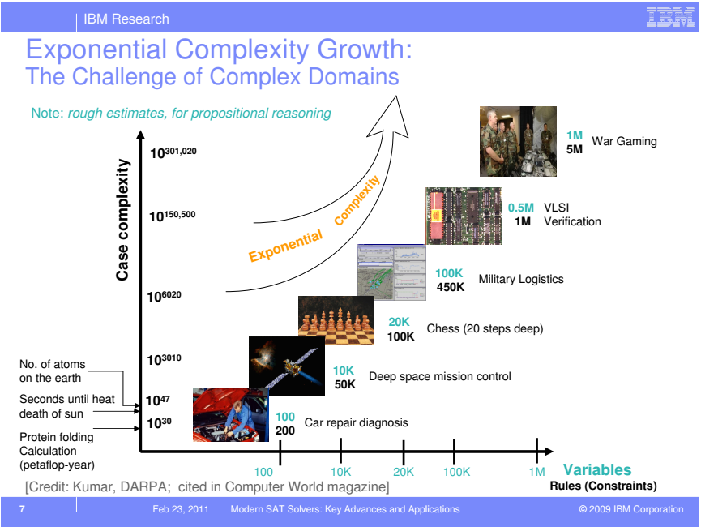

Slide 7
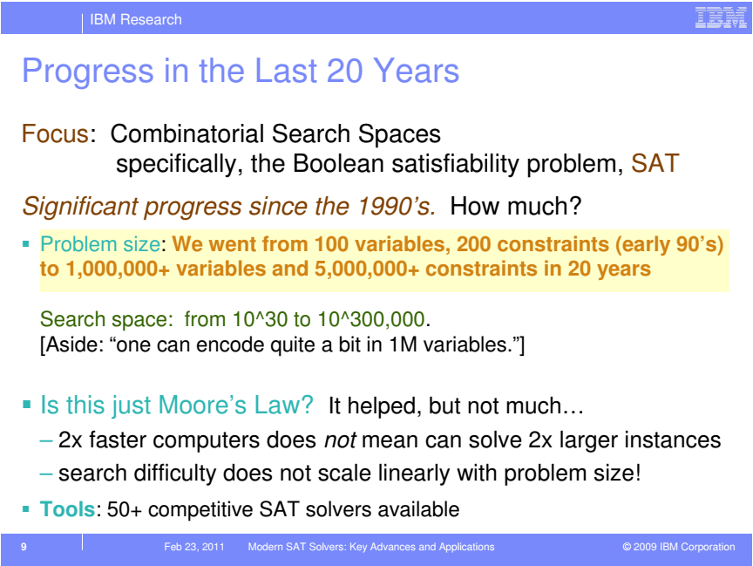

Slide 8
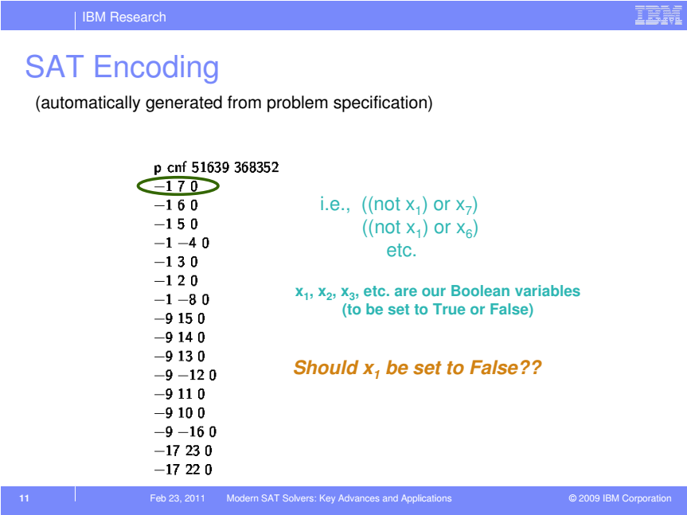

Slide 9
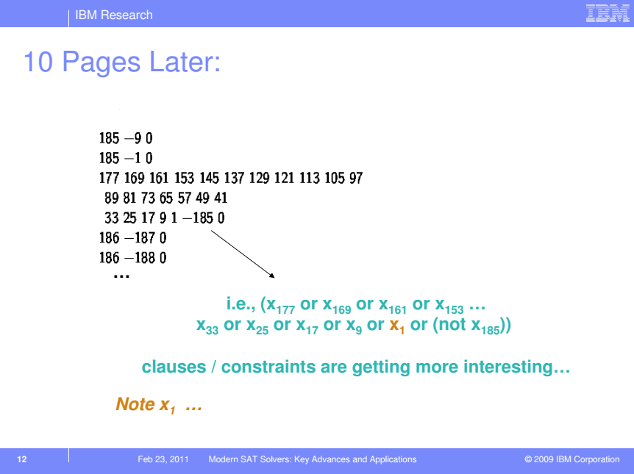

Slide 10
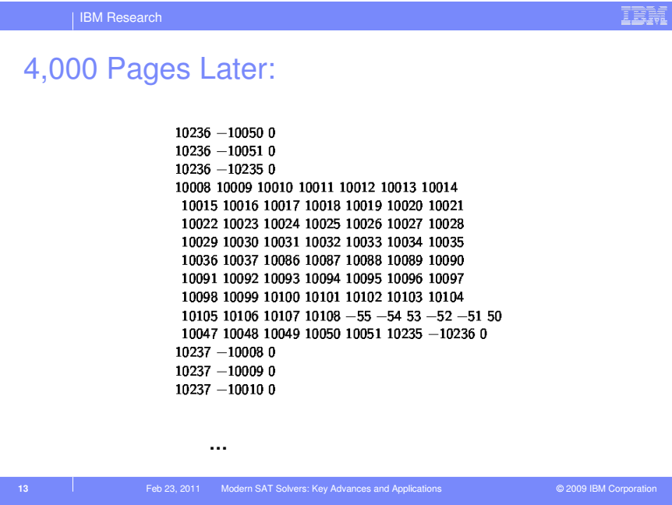

Slide 11
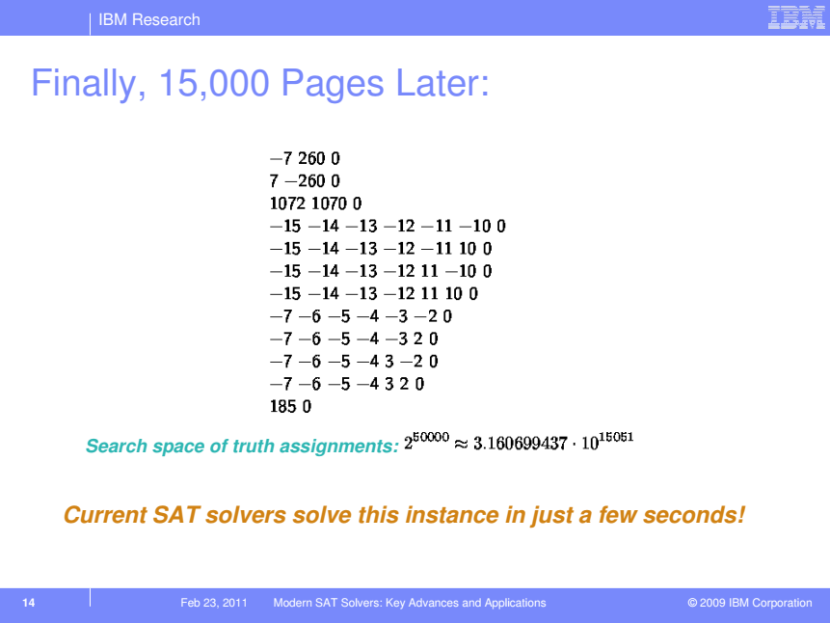

Slide 12
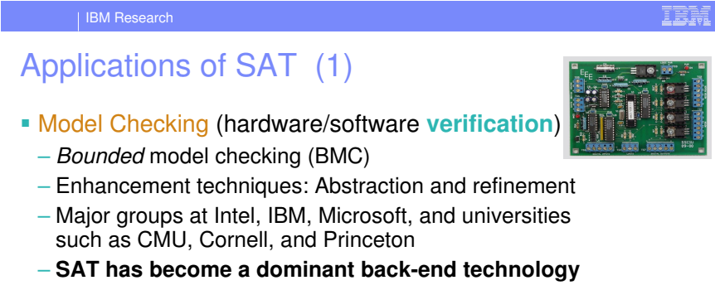
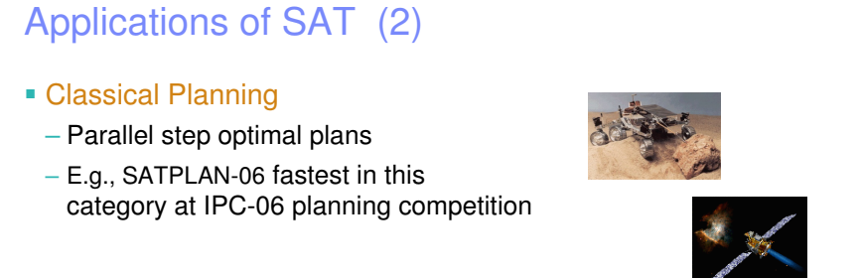

Slide 13
